Slide 1


LevelUpHub
Bridging the gap between Industry and Academia
Team 4 - LevelUpHub
PRD Presentation
Aikaterini Anagnostou
Hardik Dave
Krishna Sai Sumanth Pasupuleti
Harsh Raval
Vishaal Koushic
FALL 2025

Slide 2

Needs & Customer Segments
What is the problem?
Lack of real-world experience
High onboarding costs
Portfolio validation issues
Limited number of available internships
Target User Groups
Primary: Students and SMBs
Secondary: Universities and educators
Krishna Sai Sumanth
FALL 2025

Slide 3


Proposed Solution
Innovative Marketplace for Real Projects
For Students
Gain verifiable, real-world project experience.
Build a portfolio that stands out with company endorsements.
Create direct pathways to interviews and job offers.
For Employers
Build a diverse pipeline of proven, ready-to-work talent.
Reduce new-hire onboarding costs and time-to-productivity.
Assess real skills with a 'try-before-you-hire' model.
Krishna Sai Sumanth
FALL 2025

Slide 4
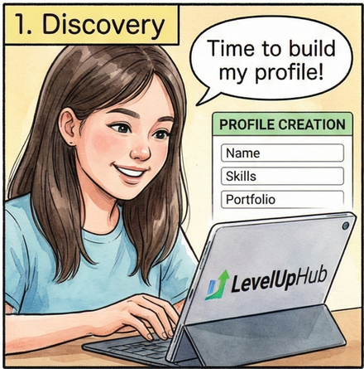
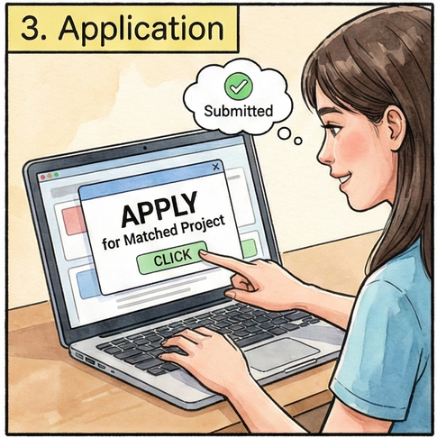
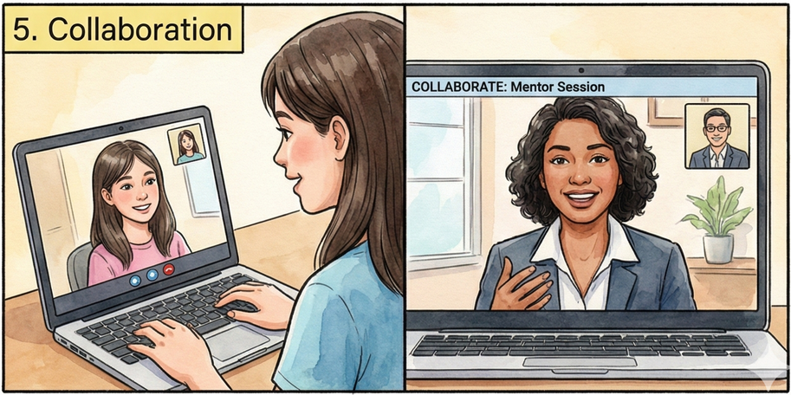

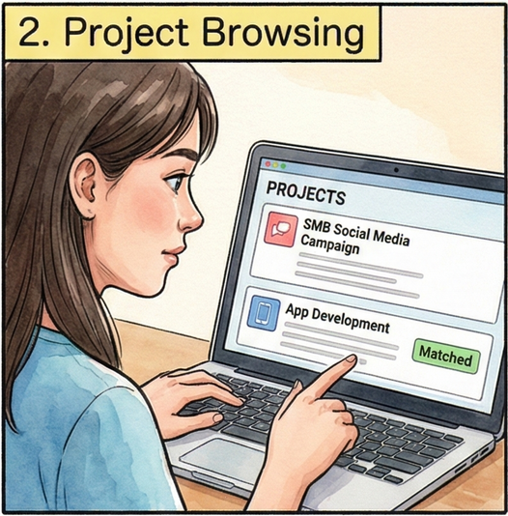

Student Journey Overview
Harsh Raval
FALL 2025

Slide 5
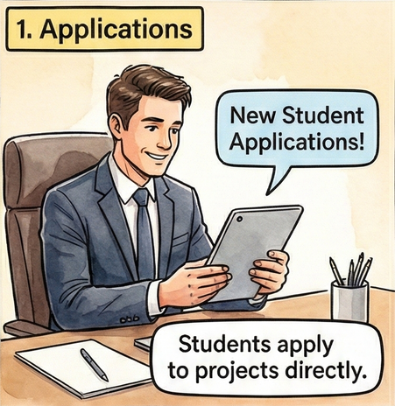
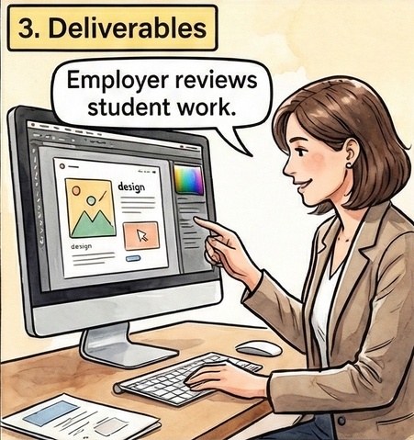
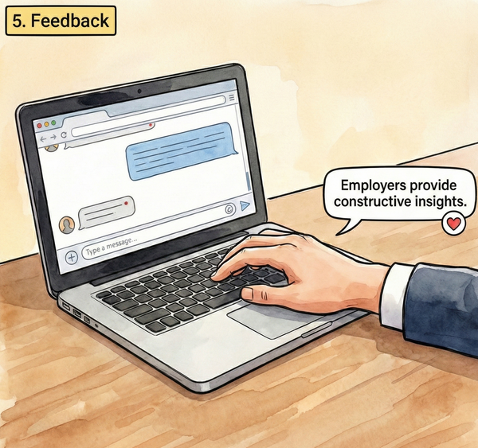
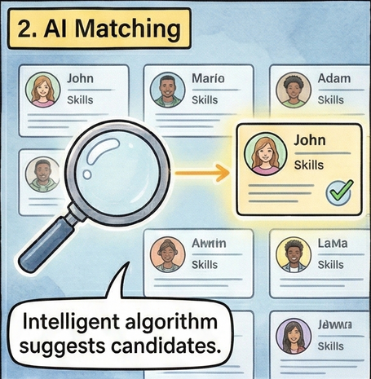
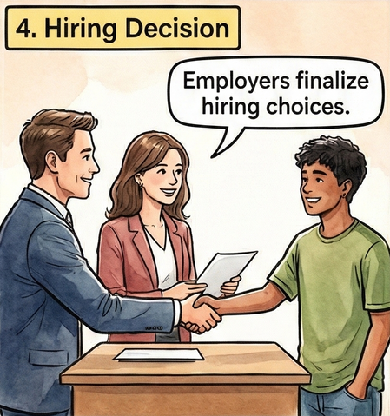
Employer Process Overview
Harsh Raval
FALL 2025

Slide 6
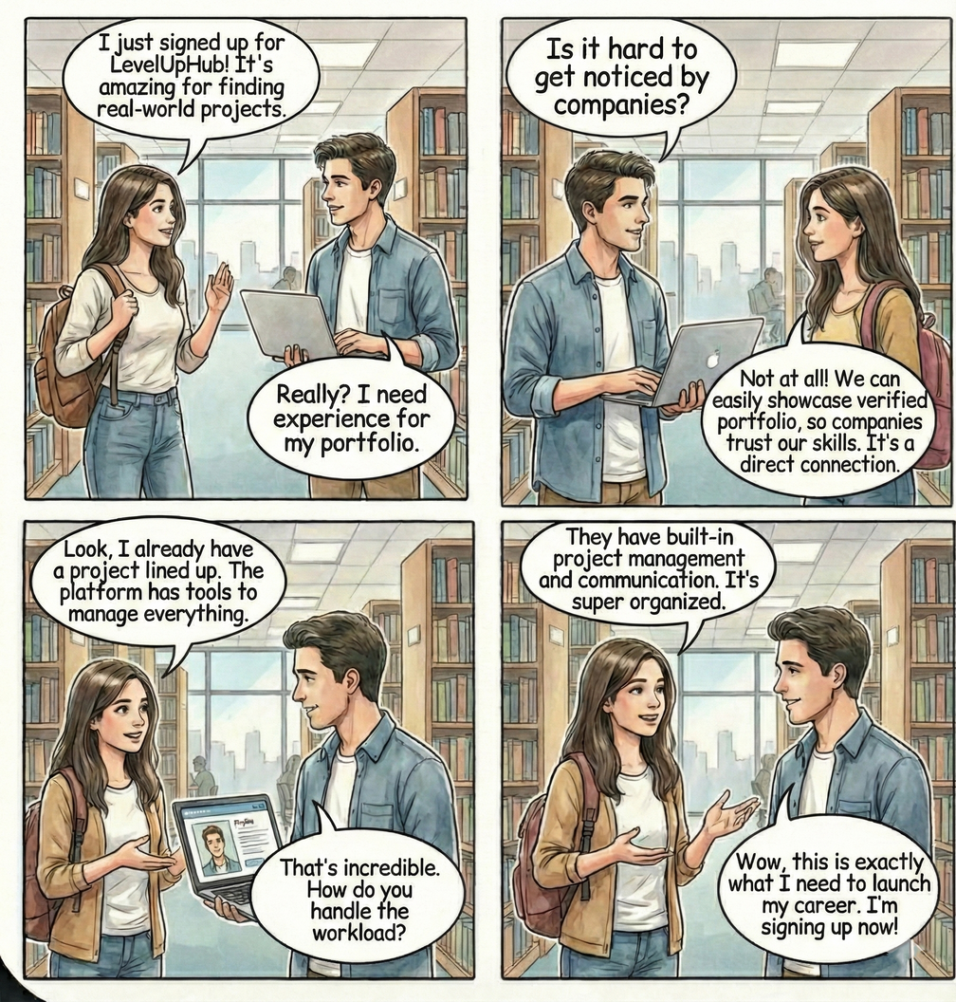
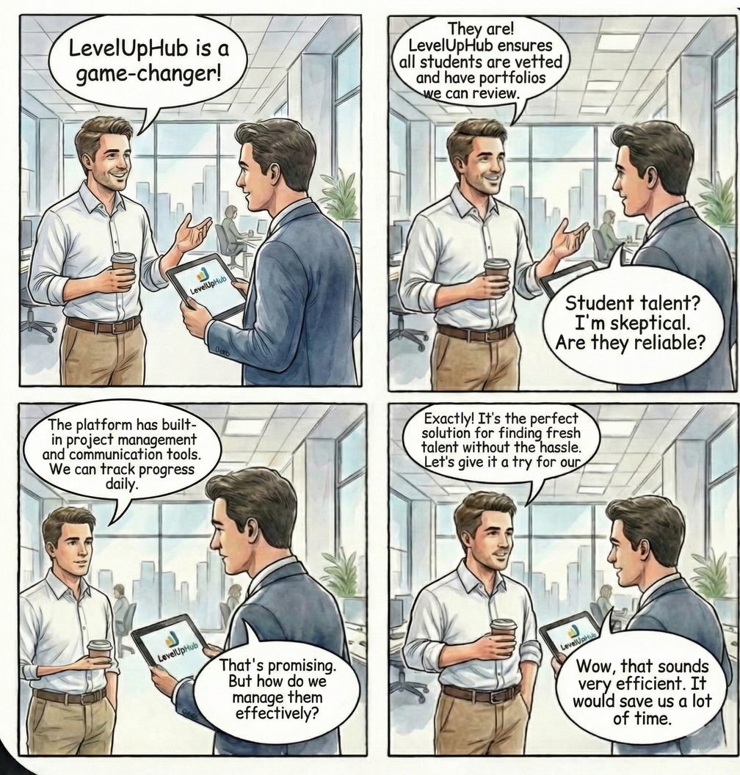
Visual Storyboard
Student Version
Employer Version
Harsh Raval
FALL 2025

Slide 7
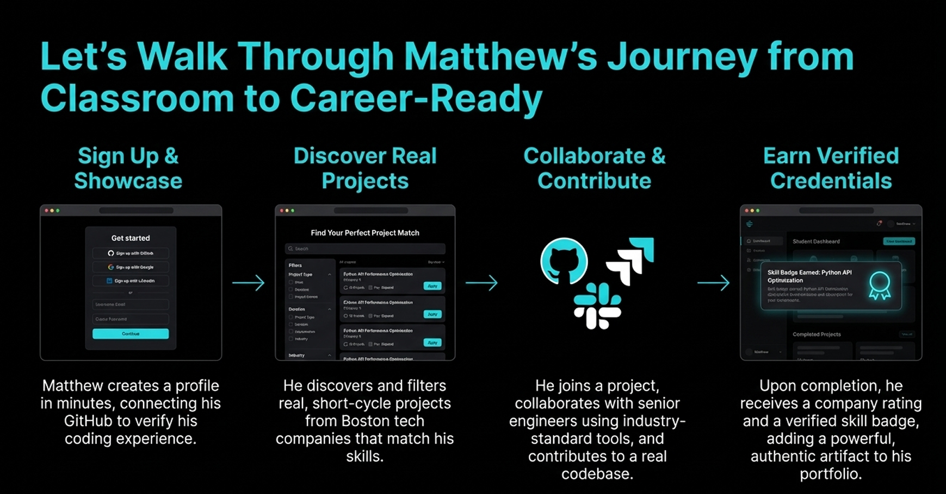
Let’s Walk Through Matthew’s Journey from Classroom to Career-Ready
Harsh Raval
FALL 2025

Slide 8




Product Roadmap
Version 1
Version 2
Version 3
Version 4
MVP release, 5 pilot companies, 50 students
$75/project pricing
75% project completion rate
20 companies, 200+ students
AI matching (85% accuracy)
GitHub PR code reviews
50 companies, 800+ students
25% hiring conversion
$75K in project fees
University partnerships (NEU, BU)
1,200+ students, 30% hiring conversion
Mobile apps, SOC 2 compliance
Q1
Q2
Q3
Q4
Go-to-Market Roadmap Focused on
Phased Growth For 2026
Hardik Dave
FALL 2025

Slide 9


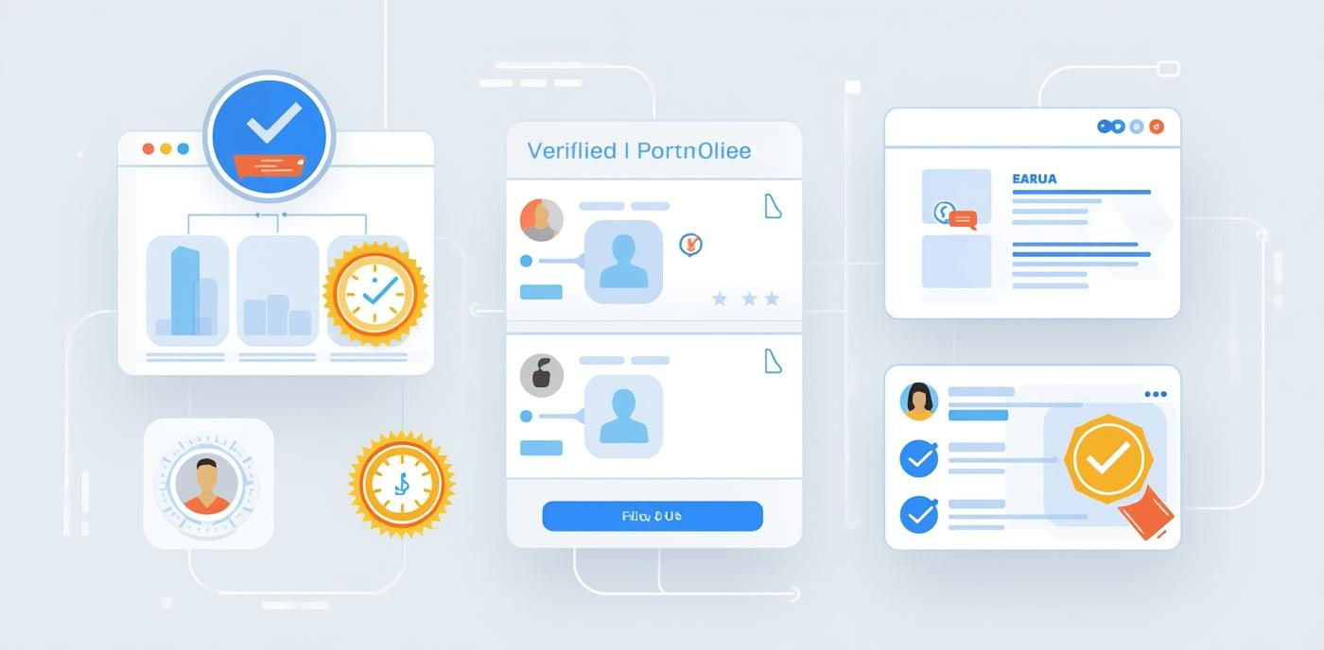


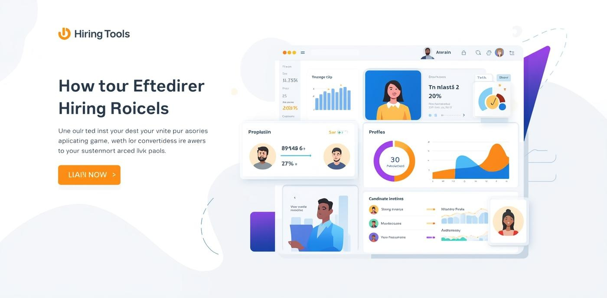
Product Features
Discovery
Matching
Verification
Browse live SMB projects easily.
AI-powered project and student matching.
Authentic portfolios for student credibility.
Posting
Tracking
Tools
Securely post projects for visibility.
Monitor performance and project success.
Access advanced hiring tools and metrics.
Hardik Dave
FALL 2025

Slide 10
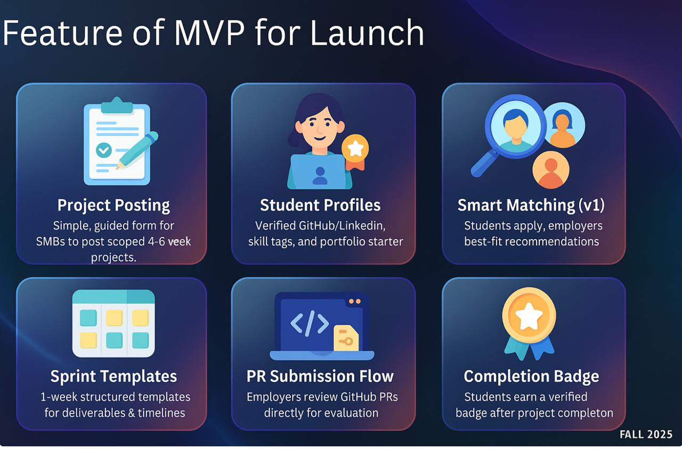
Features of MVP for launch
Hardik Dave
FALL 2025

Slide 11



Key Metrics
We Will Measure Success Across Adoption, Engagement, and Real-World Outcomes.
Adoption
(Are we growing?)
Engagement
(Is it working well?)
Outcomes
(Does it deliver value?)
Vishaal Koushic
FALL 2025

Slide 12
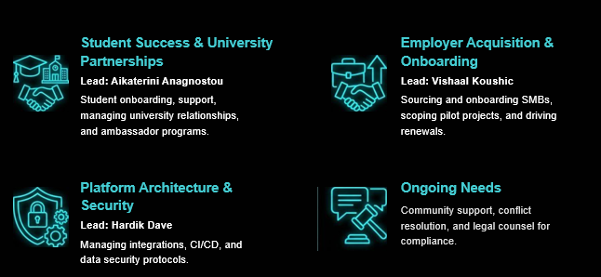
Operational Needs
Vishaal Koushic
FALL 2025

Slide 13
Projected Costs
Full Stack Engineer
Backend Integration Engineer
UI/UX Designer
QA Tester
$45/hr
$50/hr
$35/hr
$32/hr
Business Analyst
Ops and Infrastructure
Product Manager
Marketing Specialist
$32/hr
$30/hr
$45/hr
$25/hr
Total Monthly and Per Year Estimated Cost: $46,040/month and $552,480/year
Aikaterini Anagnostou
FALL 2025

Slide 14






Addressing Risks & Mitigation
Project
Quality
Employer
Adoption
Student
Matching
Data
Privacy
Platform Reliability
Market
Competition
clear project
briefs
GitHub-based submission
checks
Pilot programs with SMBs
Dedicated onboarding support
Skill-tag matching
Manual approval for employers
OAuth-secured access
Encrypted user data
Continuous QA cycles
Active monitoring and updates
Real-sprint differentiation
Local employer partnerships
Aikaterini Anagnostou
FALL 2025

Slide 15
LevelUpHub
WEBSITE
https://real-work-ready.lovable.app/
We’d love to hear from you today!
EMAIL
Dave.hard@northeastern.edu
PHONE
857-351-3835
THANK YOU !!!
FALL 2025

